Slide 1

NSG Pilkington – University of Liverpool Machine Learning Project: ?/09/2020
Dr. Peter Green
Diego Echeverria
Risk Institute,
School of Engineering

Slide 2
The previous approach: Training
Fault
Density
lag
Time
Tag 1
Time
Tag 2
Time

Slide 3
The previous approach: : Training
Fault
Density
lag
The previous approach assumed that the model input is made up of all tags at the same time lag.
Time
Tag 1
Time
Tag 2
Time

Slide 4
Training
Max lag
Fault
Density
Time
lag
Tag 1
Time
Tag 2
Time

Slide 5
Training
Max lag
Fault
Density
The model input is made up of tags at different time lags
Time
lag
Tag 1
Time
Tag 2
Time

Slide 6
Training
Max lag
Fault
Density
The model input is made up of tags at different time lags
Time
Min lag
Tag 1
Time
Tag 2
Time

Slide 7
Predictions
Now
Fault
Density
Max lag
Time
Tag 1
Time
Tag 2
Time

Slide 8
Predictions
Now
Fault
Density
Max lag
Time
Tag 1
Time
Tag 2
Time

Slide 9
Predictions
Now
Fault
Density
Max lag
Time
Tag 1
Time
Tag 2
Time

Slide 10
Predictions
Now
Fault
Density
Max lag
Time
Tag 1
Time
Tag 2
Time

Slide 11
Predictions
Now
Fault
Density
Max lag
Time
Tag 1
Time
Tag 2
Time

Slide 12
Predictions
Now
Fault
Density
Max lag
Time
Tag 1
Time
Tag 2
Time

Slide 13
Predictions
Now
Model updated with new
fault density measurement
Fault
Density
Max lag
Time
Tag 1
Time
Tag 2
Time

Slide 14
Predictions
Now
Fault
Density
Max lag
Predictions updated
Time
Tag 1
Time
Tag 2
Time

Slide 15
Predictions
Now
Fault
Density
Max lag
Predictions updated
Time
Tag 1
Time
Tag 2
Time

Slide 16
Predictions
Now
Fault
Density
Max lag
Predictions updated
Time
Tag 1
Time
Tag 2
Time

Slide 17
Predictions
Now
Fault
Density
Max lag
Predictions updated
Time
Tag 1
Time
Tag 2
Time

Slide 18
Predictions
Now
Fault
Density
Max lag
New prediction
Time
Tag 1
Time
Tag 2
Time

Slide 19
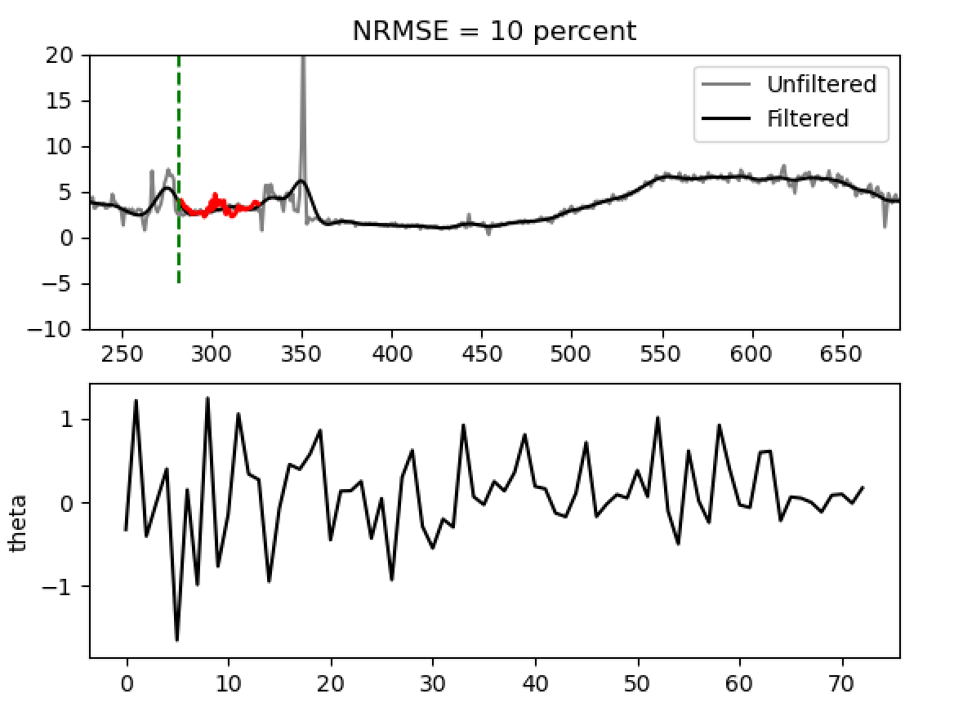
Example Results

Slide 20
Example Results
Future predictions (84 hours for now)
NRMSE over the current predictions
Model parameters; updated online as the model runs
Both filtered and unfiltered furnace faults are shown

Slide 21
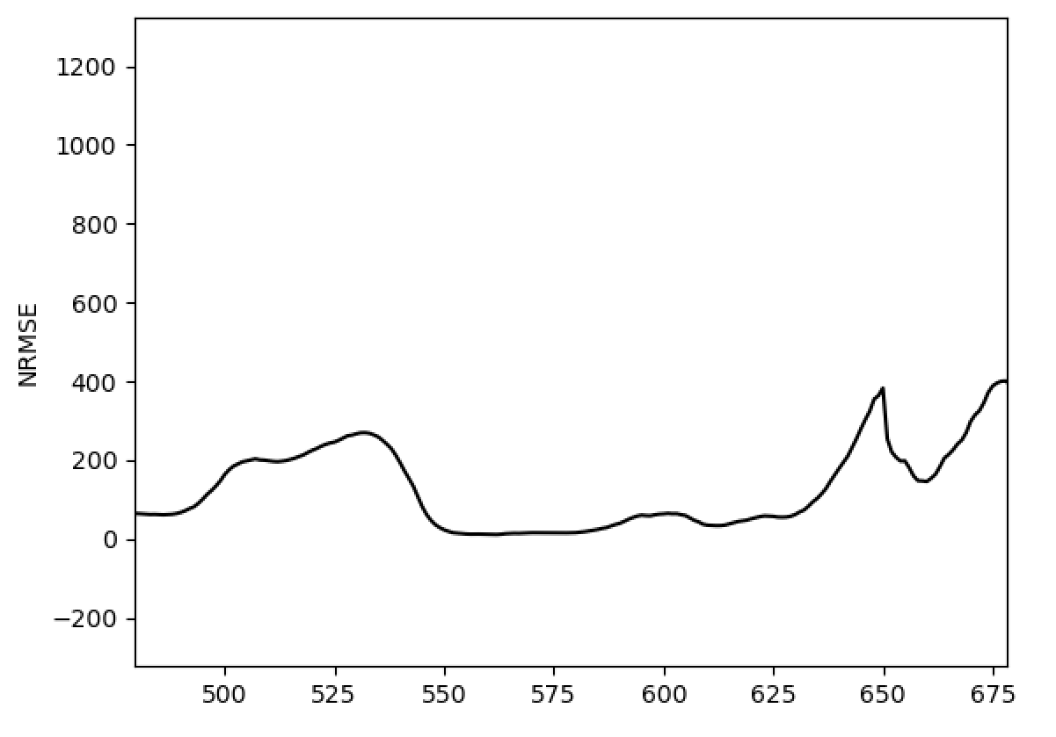
Example Results
Key next steps:
Nonlinear regression model
Regardless, it is worth considering what is causing large spikes in model performance.
A closer look at the input data as a great divergence between the predictions and the actual fault density is shown at the end of the domain

Slide 22
Thank you for your attention. ANY QUESTIONS?

